Slide 1

Design and Analysis of Algorithms

Slide 2

Greedy Method
It’s a straight forward design technique that can be applied to a wide variety of problems
Coin change problem
Let A_{n} = {a₁, a₂, a₃, …, a_{n}} be a finite set of distinct coin types (for example, a₁ = 5p, a₂ = 10p, a₃ = 20p, a₄ =25p, a₅ =50p and so on.)
Assume each a_{i} is an integer and a₁ > a₂ > a₃ …….. a_{n}.
Each type is available in unlimited quantity.
The coin-changing problem is to make up an exact amount C using a minimum total number of coins.
C is an integer >0.

Slide 3
Greedy Method
Lets take an example
X goes to a shop to buy an item worth 30p and hands over 1Rs.
What is the change expected by X? 70p
Probable set of coins given by shop keeper
A={10, 20, 20, 20}
B={10, 10, 10, 10 ,10 ,10, 10}
C={5, 5, 5, 5, 5, 5, 5, 5, 5, 5, 5, 5, 5, 5}
D={25 ,25 ,20}
E={50, 20}
F= {50, 10, 10}
What was the constraint?
The sum of the coins given by the shopkeeper =70p
The subset that satisfies this constraint is called feasible solution
The feasible solution that maximizes/minimizes the objective function is called an optimal solution

Slide 4
Greedy Method
Greedy algorithms work in stages
At each stage, a decision is made regarding whether a particular input is in an optimal solution.
This is done by considering the inputs in an order determined by some selection procedure.
If the inclusion of the next input into the partially constructed optimal
Solution will result in an infeasible solution, then this input is not added to the partial solution, otherwise, it is added

Slide 5
Greedy Method
Control Abstraction
Algorithm Greedy(a, n)
// a[1:n] contains the n inputs.
{
solution:=0;// Initialize the solution.
for i :=1 to n do
{
x :=Select(a);
if Feasible(solution, x) then
solution:=Union (solution, x);
}
return solution;
}

Slide 6
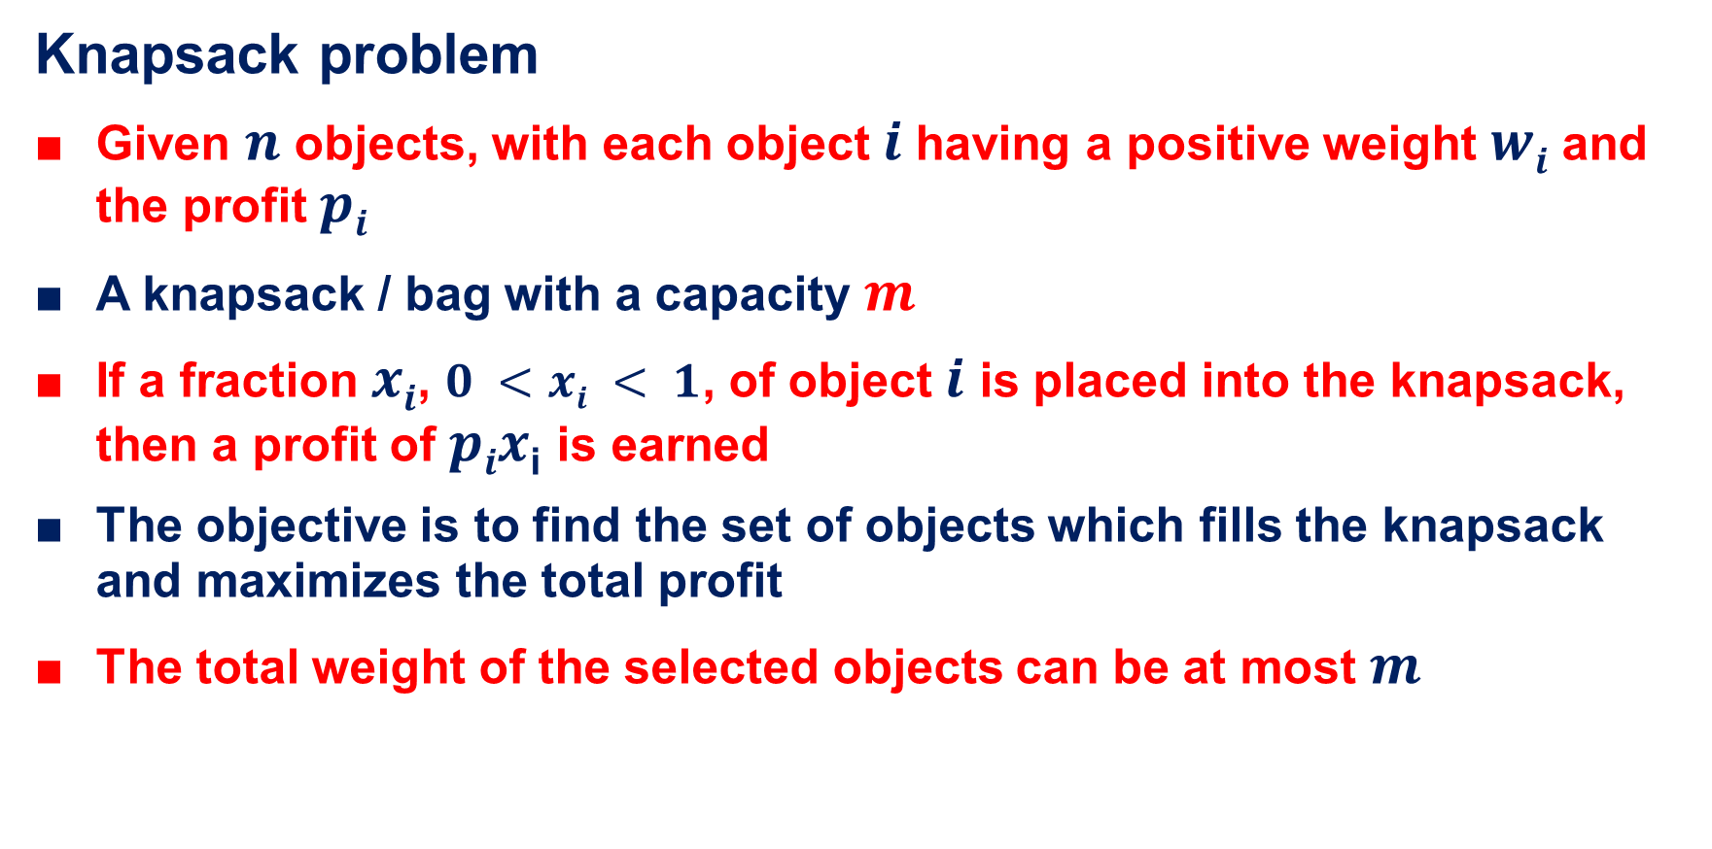
Greedy Method
Knapsack problem
Given $n$ objects, with each object $i$having a positive weight $wi$ and the profit $pi$
A knapsack / bag with a capacity $m$
If a fraction $xi$, $0 <xi < 1$, of object $i$ is placed into the knapsack, then a profit of $pix$_{i} is earned
The objective is to find the set of objects which fills the knapsack and maximizes the total profit
The total weight of the selected objects can be at most $m$

Slide 7

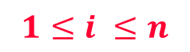
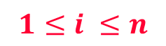
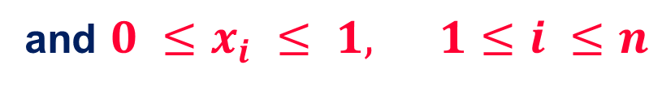
Greedy Method
Formal definition of Knapsack problem
maximize
p_{i} x_{i}
$$1≤i ≤n$$
subject to
w_{i} x_{i} $≤$ m
$$1≤i ≤n$$
and $0 ≤x_{i} ≤ 1, 1≤i ≤n$
xi = 1 when item i is selected and let xi = 0 when item i is not selected.

Slide 8
Greedy Method
Example
Consider the following instance of the knapsack problem
n = 3, m= 20, (p₁,p₂,p₃)=(25,24,15) and (w₁,w₂,w₃)= (18,15,10).
Find all the feasible solutions and hence an optimal solution
First feasible solution
Consider the objects according to their profit ( descending order)
Object with largest profit is considered first and so on
Object 1 (highest profit) with weight 18 can be put into the knapsack in its entirety . So x1=1 and RemCap =2
Object 2 ( second highest profit) with weight 15 is considered but cant be put into the bag in its entirety (RemCap<w2)
Hence a fraction 2/15 is put into the knapsack, x2=2/15, RemCap =0

Slide 9
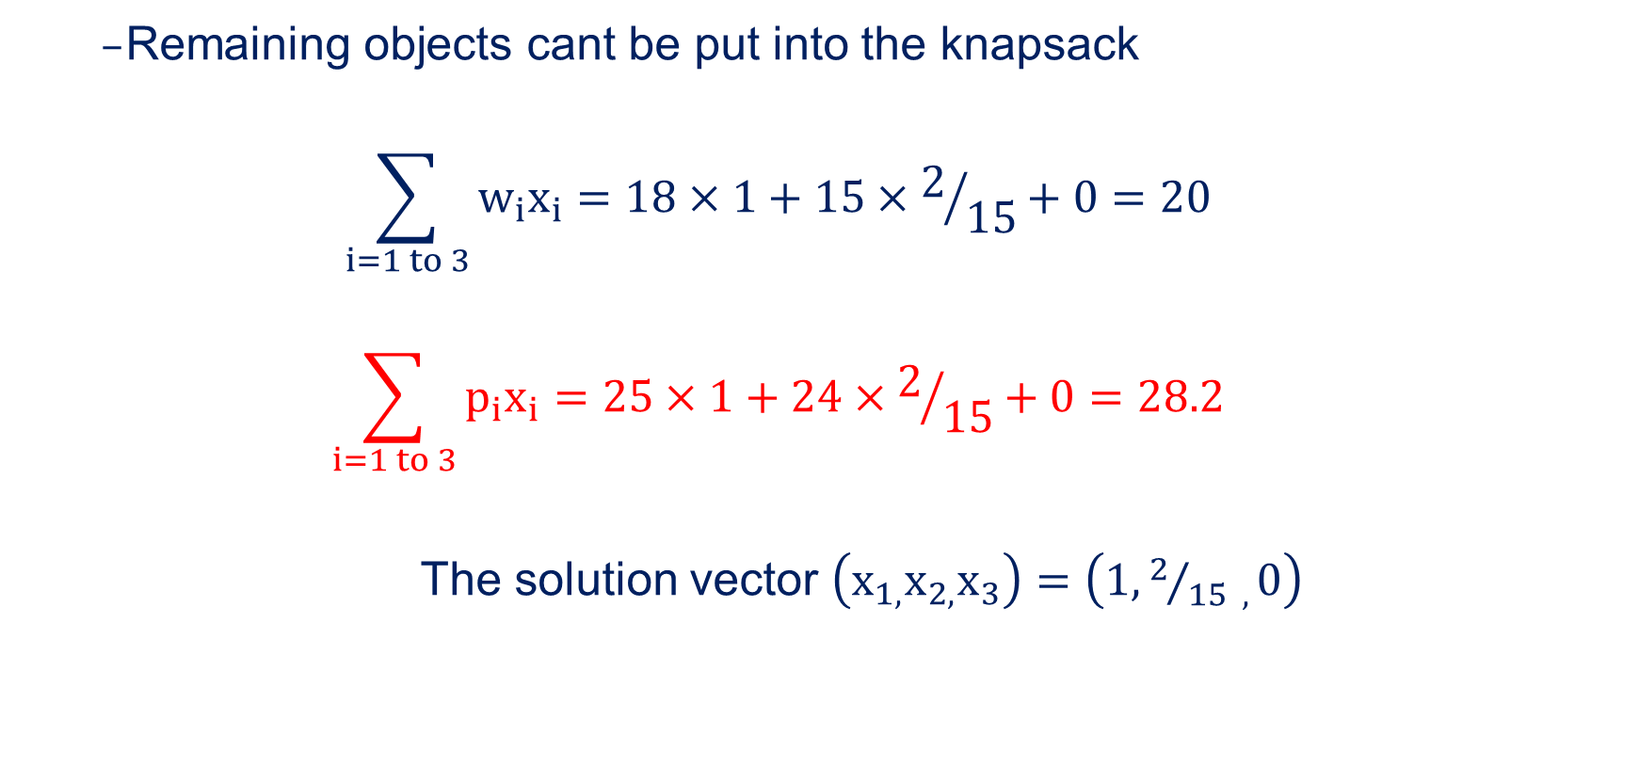
Greedy Method
Remaining objects cant be put into the knapsack
$$\sum_{i=1 to 3}{w_{i}x_{i}=18×1+15×2/{15}+0=20}$$
$$\sum_{i=1 to 3}{p_{i}x_{i}=25×1+24×2/{15}+0=28.2}$$
The solution vector $\left(x_{1,}x_{2,}x_{3}\right)=\left(1, 2/{15 ,}0\right)$

Slide 10
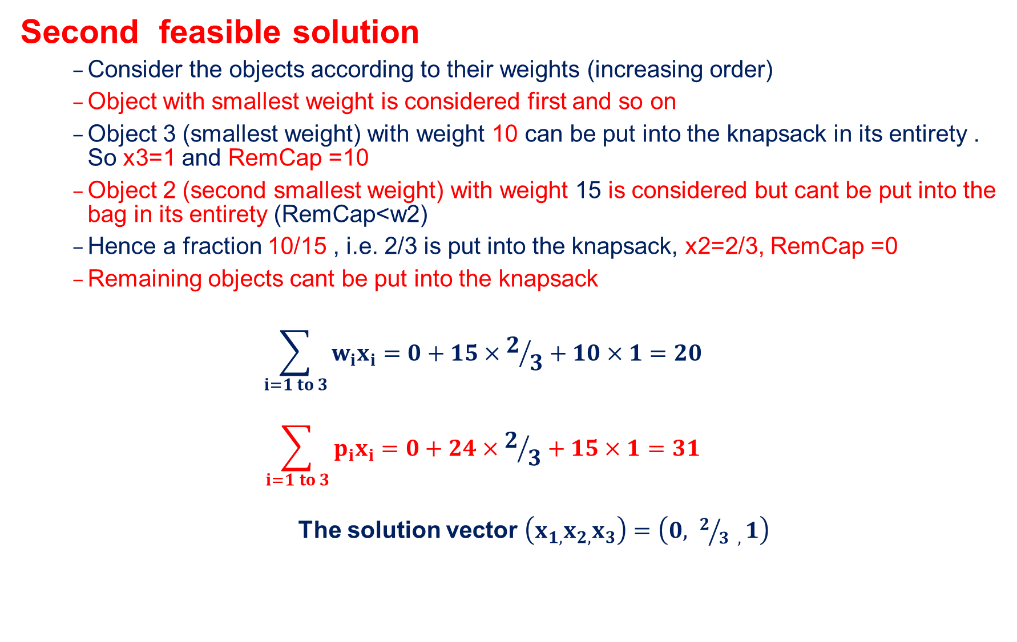
Greedy Method
Second feasible solution
Consider the objects according to their weights (increasing order)
Object with smallest weight is considered first and so on
Object 3 (smallest weight) with weight 10 can be put into the knapsack in its entirety . So x3=1 and RemCap =10
Object 2 (second smallest weight) with weight 15 is considered but cant be put into the bag in its entirety (RemCap<w2)
Hence a fraction 10/15 , i.e. 2/3 is put into the knapsack, x2=2/3, RemCap =0
Remaining objects cant be put into the knapsack
$$\sum_{i=1 to 3}{w_{i}x_{i}=0+15×2/3+10×1=20}$$
$$\sum_{i=1 to 3}{p_{i}x_{i}=0+24×2/3+15×1=31}$$
The solution vector $\left(x_{1,}x_{2,}x_{3}\right)=\left(0, 2/{3 ,}1\right)$

Slide 11
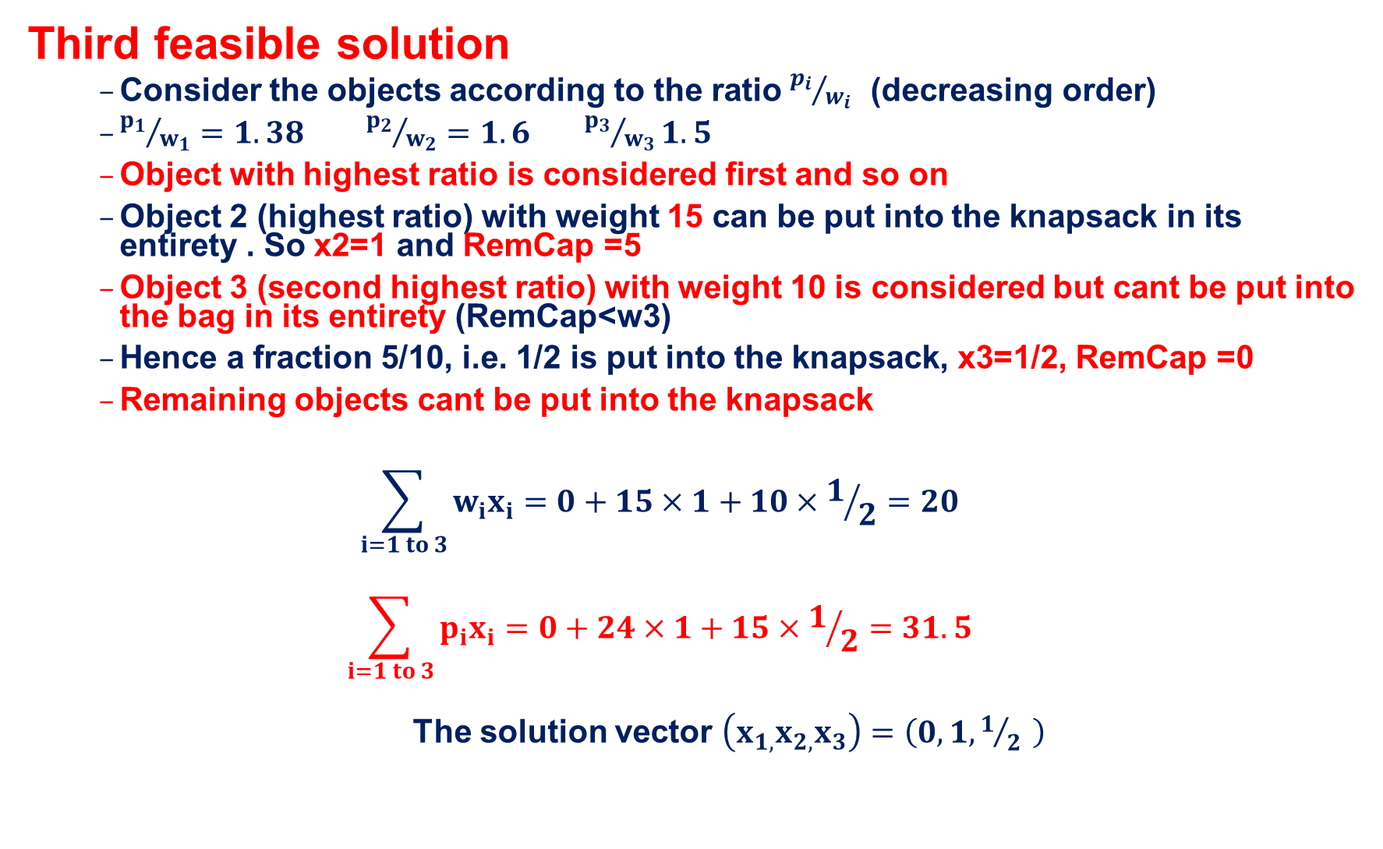
Greedy Method
Third feasible solution
Consider the objects according to the ratio ${p_{i}}/{w_{i}}$ (decreasing order)
${p_{1}}/{w_{1}}=1.38$ ${p_{2}}/{w_{2}}=1.6$ ${p_{3}}/{w_{3}}1.5$
Object with highest ratio is considered first and so on
Object 2 (highest ratio) with weight 15 can be put into the knapsack in its entirety . So x2=1 and RemCap =5
Object 3 (second highest ratio) with weight 10 is considered but cant be put into the bag in its entirety (RemCap<w3)
Hence a fraction 5/10, i.e. 1/2 is put into the knapsack, x3=1/2, RemCap =0
Remaining objects cant be put into the knapsack
$$\sum_{i=1 to 3}{w_{i}x_{i}=0+15×1+10×1/2=20}$$
$$\sum_{i=1 to 3}{p_{i}x_{i}=0+24×1+15×1/2=31.5}$$
The solution vector $\left(x_{1,}x_{2,}x_{3}\right)=\left(0,1, 1/{2 }\right)$

Slide 12
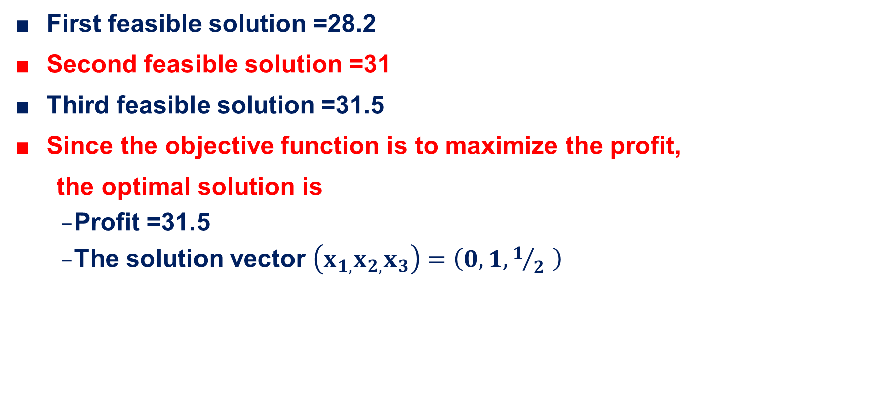
Greedy Method
First feasible solution =28.2
Second feasible solution =31
Third feasible solution =31.5
Since the objective function is to maximize the profit,
the optimal solution is
Profit =31.5
The solution vector $\left(x_{1,}x_{2,}x_{3}\right)=\left(0,1, 1/{2 }\right)$

Slide 13
Greedy Method
Homework
Consider the following instance of the knapsack problems.
Find all the feasible solutions and hence an optimal solution n = 3, m= 20, (p₁,p₂,p₃)=(30, 21, 18) and (w₁,w₂,w₃)= (18,15,10).
Find all the feasible solutions and hence an optimal solution N=7, m=15, pi=(10,5,15,7,6,18,3) and wi=(2,3,5,7,1,4,1)

Slide 14
Greedy Method
ALGORITHM Greedy_Knapsack(m,n)
{
for( i = 1 to n ) do x[ i ] = 0.0
u=m
for( i = 1 to n ) do
{
if( w[ i ]>u ) then break
x[ i ] = 1.0
u=u-w[ i ]
}
if( i <= n ) then
x[ i ] = u/w[ i ]
}

Slide 15
Introduction to Graphs
A graph G = (V, E)
V = set of vertices
E = set of edges = subset of V × V
Thus |E| = O(|V|²)
1
Vertices: {1, 2, 3, 4}
Edges: {(1, 2), (2, 3), (1, 3), (4, 3)}
2
4
3

Slide 16
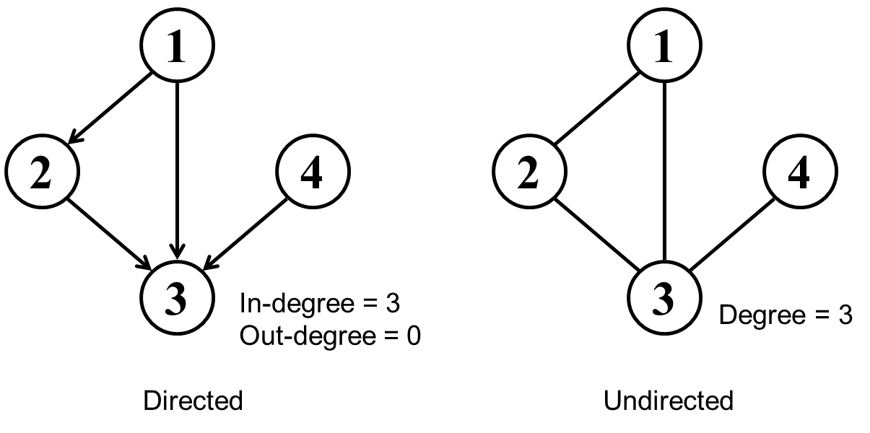
Graph – Variations
Directed / undirected:
In an undirected graph:
Edge (u,v) ∈ E implies edge (v,u) ∈ E
Road networks between cities
In a directed graph:
Edge (u,v): u→v does not imply v→u
Street networks in downtown
Degree of vertex v:
The number of edges adjacency to v
For directed graph, there are in-degree and out-degree

Slide 17
Graph – Variations
1
1
2
4
2
4
3
3
In-degree = 3
Out-degree = 0
Degree = 3
Directed
Undirected

Slide 18
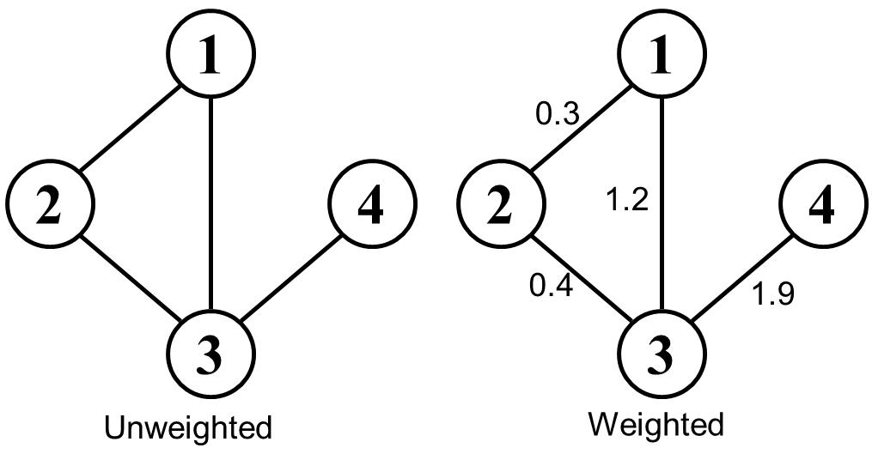
Graph – Variations
Weighted / unweighted:
In a weighted graph, each edge or vertex has an associated weight (numerical value)
E.g., a road map: edges might be weighted w/ distance
.

Slide 19
Graph – Variations
Connected / disconnected:
A connected graph has a path from every vertex to every other
A directed graph is strongly connected if there is a directed path between any two vertices
1
Connected but not strongly connected
2
4
3

Slide 20
Graph – Variations
Dense / sparse:
Graphs are sparse when the number of edges is linear to the number of vertices
|E| ∈ O(|V|)
Graphs are dense when the number of edges is quadratic to the number of vertices
|E| ∈ O(|V|²)
Most graphs of interest are sparse
If you know you are dealing with dense or sparse graphs, different data structures may make sense

Slide 21
Representing Graphs
Assume V = {1, 2, …, n}
An adjacency matrix represents the graph as a n x n matrix A:
A[i, j] = 1 if edge (i, j) ∈ E = 0 if edge (i, j) ∉ E
For weighted graph
A[i, j] = w_{ij} if edge (i, j) ∈ E
= 0 if edge (i, j) ∉ E
For undirected graph
Matrix is symmetric: A[i, j] = A[j, i]

Slide 22
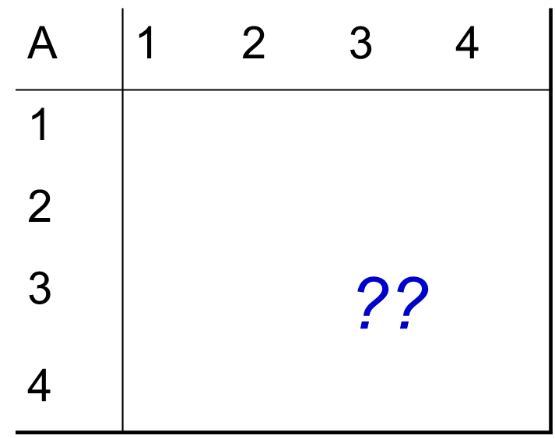
Graphs: Adjacency Matrix
Example:
1
2
4
3

Slide 23
Graphs: Adjacency Matrix
Example
A
1
2
3
4
1
1
0
1
1
999
2
4
2
1
0
1
0
3
1
1
0
1
3
4
999
0
1
0
Undirected graph

Slide 24
Graphs: Adjacency Matrix
Example
1
A
1
2
3
4
5
1
0
5
6
999
2
6
4
2
5
0
9
0
9
4
3
6
9
0
4
3
4
999
0
4
0
Weighted graph

Slide 25
Graphs: Adjacency List
Adjacency list: for each vertex v ∈ V, store a list of vertices adjacent to v
Example:
Adj[1] = {2,3}
Adj[2] = {3}
Adj[3] = {}
Adj[4] = {3}
Variation: can also keep a list of edges coming into vertex
1
2
4
3

Slide 26
Graphs: Adjacency List
Adjacency list
1
2
3
3
2
4
3
3
How much storage does the adjacency list require?
A: O(V+E)

Slide 27
Graphs: Adjacency List
Undirected graph
1
A
1
2
3
4
1
0
1
1
0
2
4
2
1
0
1
0
3
1
1
0
1
3
4
0
0
1
0
2
3
1
3
1
2
4
3

Slide 28
Graphs: Adjacency List
Weighted graph
A
1
2
3
4
1
1
0
5
6
0
5
2
5
0
9
0
2
6
4
3
6
9
0
4
9
4
4
0
0
4
0
3
2,5
3,6
1,5
3,9
1,6
2,9
4,4
3,4

Slide 29
Trade of between two representations
|V| = n, |E| = m
 | Adj Matrix | Adj List
test (u, v) ∈ E | Θ(1) | O(n)
Degree(u) | Θ(n) | O(n)
Memory | Θ(n²) | Θ(n+m)
Edge insertion | Θ(1) | Θ(1)
Edge deletion | Θ(1) | O(n)
Graph traversal | Θ(n²) | Θ(n+m)
Both representations are very useful and have different properties, although adjacency lists are probably better for more problems

Slide 30
Problems
Given a set of cities, how to construct minimum length of highways to connect the cities so that there are paths between every two cities?

Slide 31
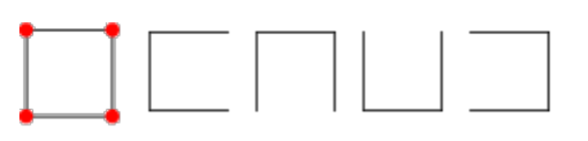
Spanning Tree
Definition
Let G = (V, E) be an undirected connected graph.
A subgraph t = (V, E’) of G is a spanning tree of G iff t is a tree
Graph
Sp. Tree 1
Sp. Tree 2
Sp. Tree 3
Sp. Tree 4

Slide 32
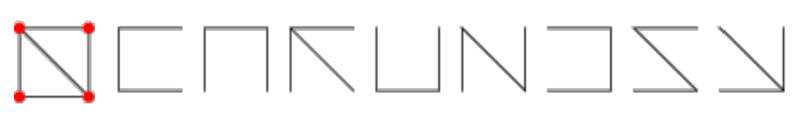
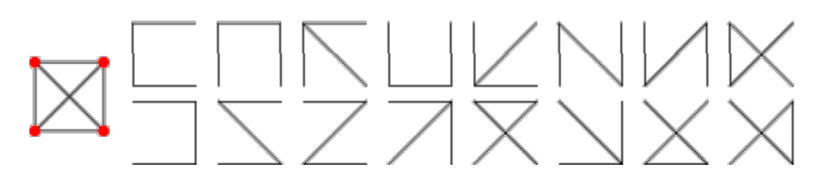
Spanning Tree
Graph
Spanning Trees
Graph
Spanning Trees

Slide 33
Spanning Tree
A spanning tree of an undirected connected graph is its connected acyclic subgraph (i.e., a tree) that contains all the vertices of the graph.
For a weighted graph, a minimum spanning tree is its spanning tree of the smallest weight, where the weight of a tree is defined as the sum of the weights on all its edges.
The minimum spanning tree problem is the problem of finding a minimum spanning tree for a given weighted connected graph.

Slide 34
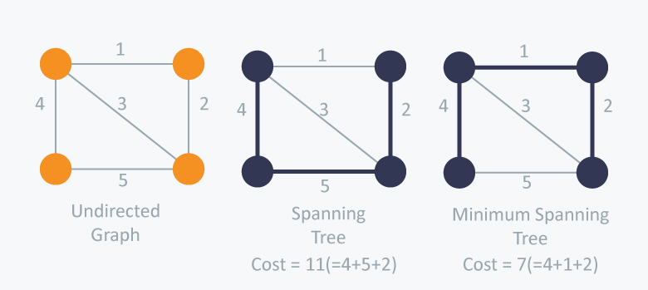
Spanning Tree

Slide 35
Prims Algorithm
A greedy method to obtain a minimum-cost spanning tree builds this tree edge by edge.
The next edge to include is chosen according to some optimization criterion.
The simplest such criterion is to choose an edge that results in a minimum increase in the sum of the costs of the edges so far included

Slide 36
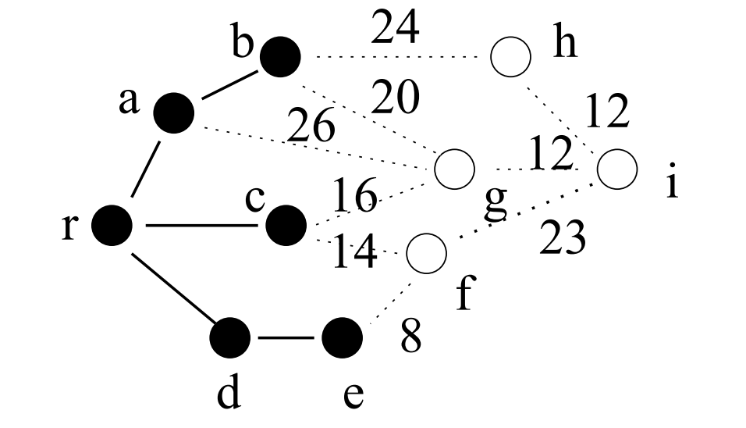
Prims Algorithm – Illustration
Tree Vertices - { r, a, b, c, d, e } – vertices that re part of the spanning tree
Fringe vertices - { h, g, f } – vertices not in the tree but adjacent to at least one vertex that is in the tree
Unseen vertices – { i } – vertices not yet affected by the algorithm

Slide 37
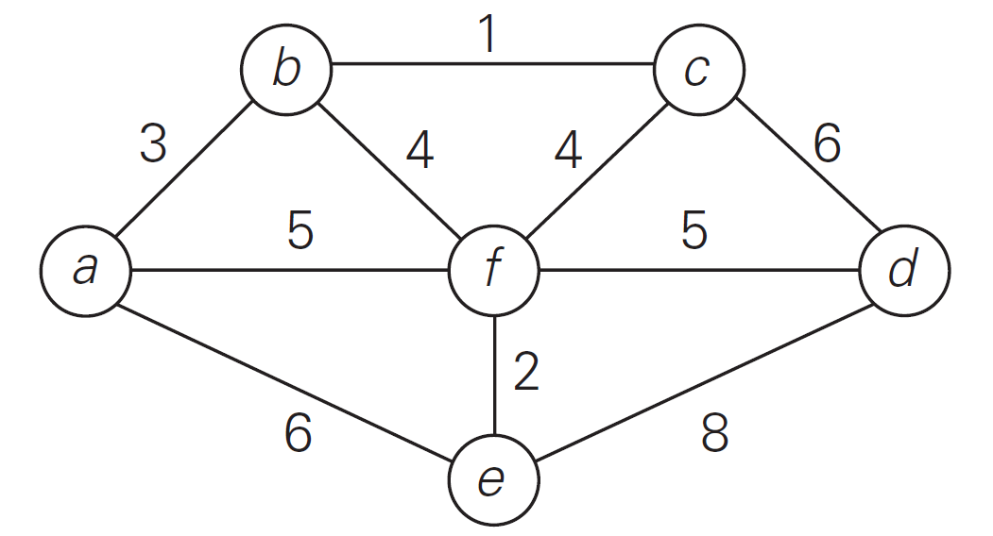
Prims Algorithm – Problem
Find the minimum cost spanning tree for the following graph
Solution

Slide 38
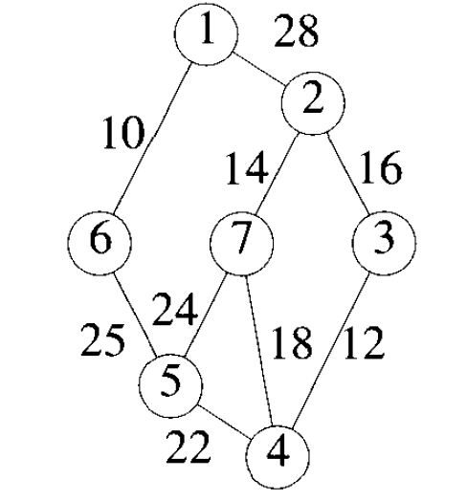
Prims Algorithm – Problem
Find the minimum cost spanning tree for the following graph

Slide 39
Prims Algorithm- Example
The cost of the minimum spanning tree is 99

Slide 40
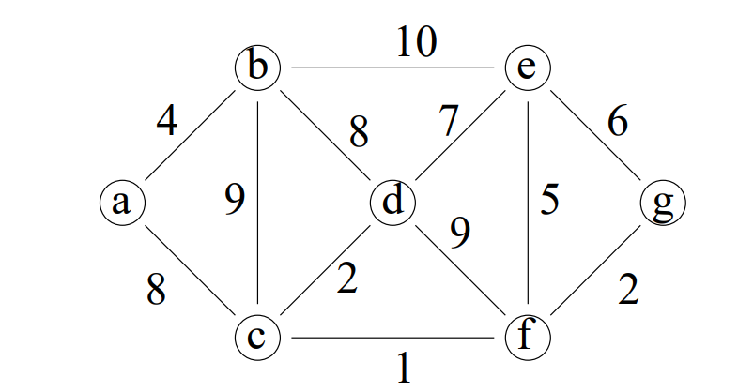
Prims Algorithm – Problem Home work
Find the minimum cost spanning tree for the following graph

Slide 41
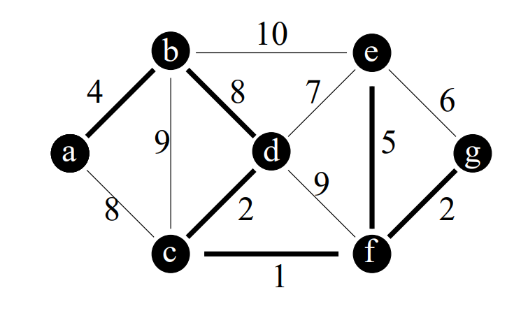
Prims Algorithm – Problem Home work – solution
The cost of the minimum spanning tree is 22

Slide 42
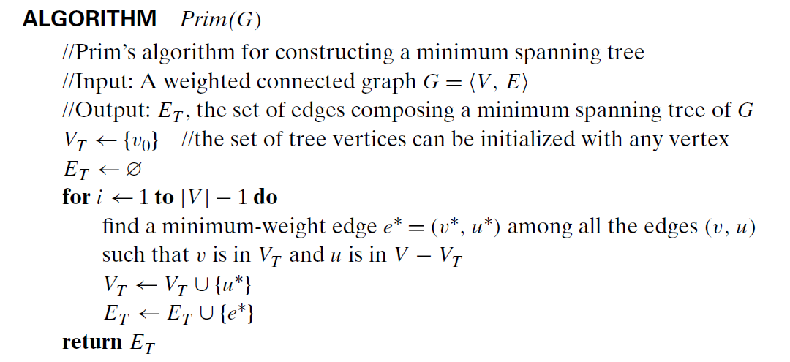
Prims Algorithm

Slide 43
Kruskal’s Algorithm
Joseph Kruskal developed an algorithm - Kruskal’s Algorithm - to find an optimal solution to minimum spanning tree problem when he was a second year graduate student
Prim’s algorithm grew the minimum spanning tree by including nearest vertex to the vertices already in the tree
In Prim’s algorithm, the subgraphs were always connected in the intermediate stages
The Kruskal’s algorithm begins by sorting the edges in increasing order of their weights
Starting with the empty subgraph, it scans this sorted list, adding the next edge on the list to the current subgraph if such an inclusion does not create a cycle and simply skipping the edge otherwise

Slide 44
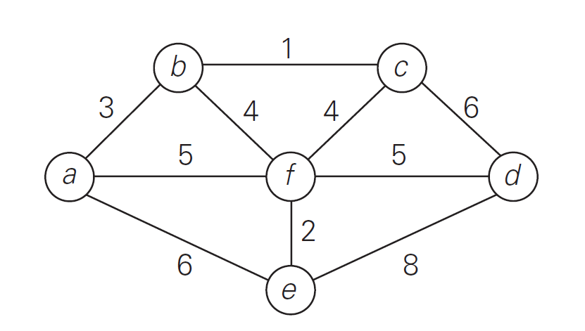
Kruskal’s Algorithm - Problem
Find the minimum cost spanning tree for the following graph

Slide 45
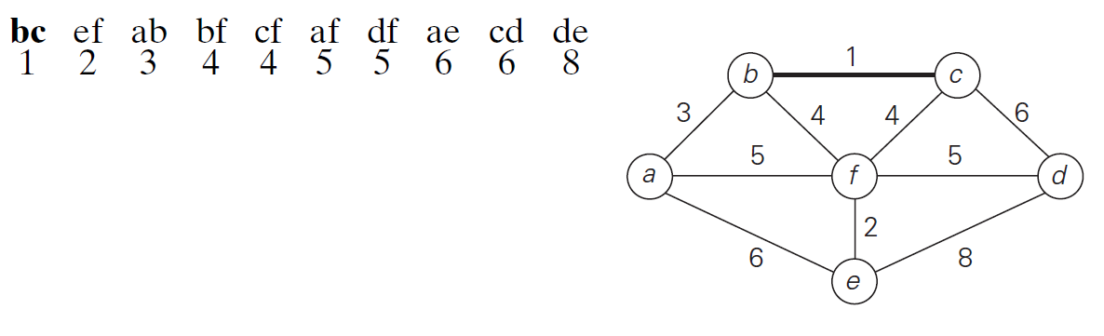
Kruskal’s Algorithm - Solution

Slide 46
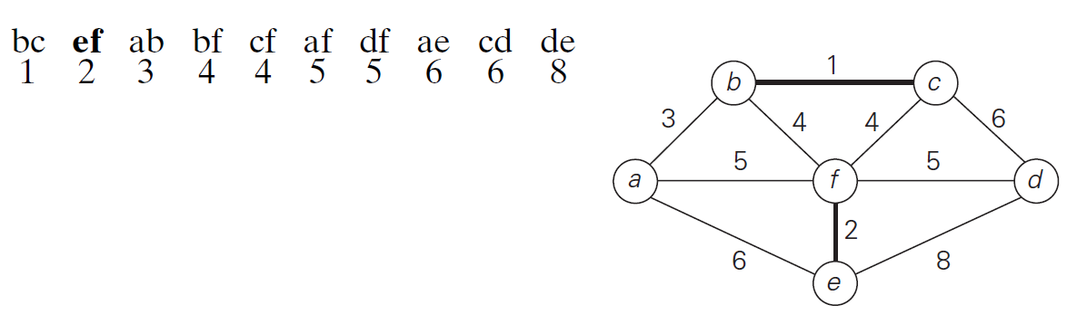
Kruskal’s Algorithm - Solution

Slide 47
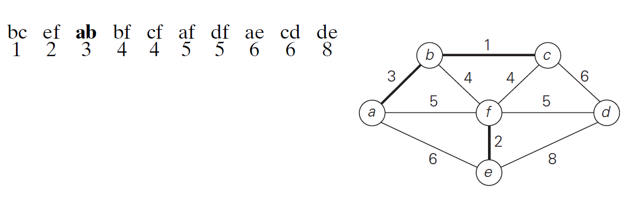
Kruskal’s Algorithm - Solution

Slide 48
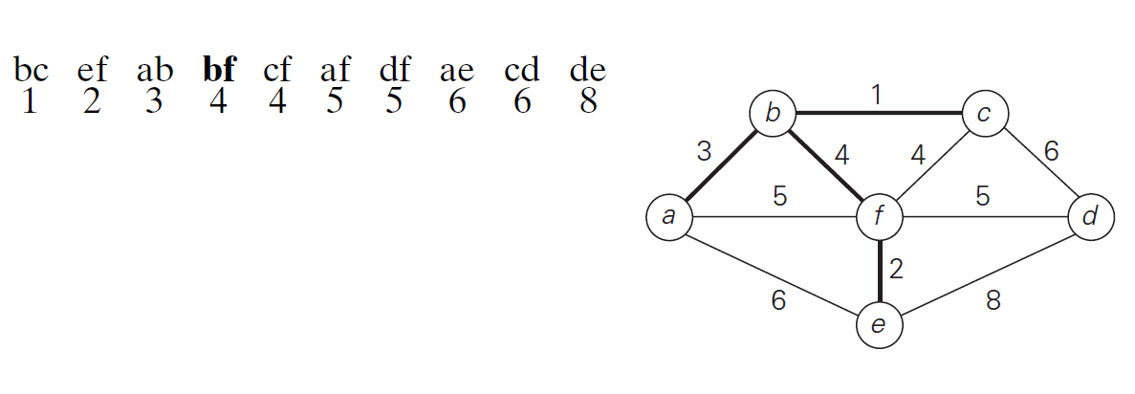
Kruskal’s Algorithm - Solution

Slide 49
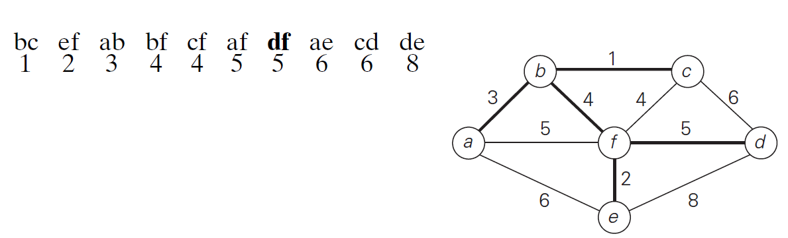
Kruskal’s Algorithm - Solution
Total cost of the minimum spanning tree= 15

Slide 50
Kruskal’s Algorithm - Problem
Find the minimum cost spanning tree for the following graph
a
6
12
5
9
b
f
g
14
7
8
15
c
e
h
3
10
d

Slide 51
Kruskal’s Algorithm - Solution
c-d: 3
b-f: 5
b-a: 6
f-e: 7
b-d: 8
f-g: 9
d-e: 10
a-f: 12
b-c: 14
e-h: 15
a
6
12
5
9
b
f
g
14
7
8
15
c
e
h
3
10
d

Slide 52
Kruskal’s Algorithm - Solution
c-d: 3
b-f: 5
b-a: 6
f-e: 7
b-d: 8
f-g: 9
d-e: 10
a-f: 12
b-c: 14
e-h: 15
a
6
12
5
9
b
f
g
14
7
8
15
c
e
h
3
10
d

Slide 53
Kruskal’s Algorithm - Solution
c-d: 3
b-f: 5
b-a: 6
f-e: 7
b-d: 8
f-g: 9
d-e: 10
a-f: 12
b-c: 14
e-h: 15
a
6
12
5
9
b
f
g
14
7
8
15
c
e
h
3
10
d

Slide 54
Kruskal’s Algorithm - Solution
c-d: 3
b-f: 5
b-a: 6
f-e: 7
b-d: 8
f-g: 9
d-e: 10
a-f: 12
b-c: 14
e-h: 15
a
6
12
5
9
b
f
g
14
7
8
15
c
e
h
3
10
d

Slide 55
Kruskal’s Algorithm - Solution
c-d: 3
b-f: 5
b-a: 6
f-e: 7
b-d: 8
f-g: 9
d-e: 10
a-f: 12
b-c: 14
e-h: 15
a
6
12
5
9
b
f
g
14
7
8
15
c
e
h
3
10
d

Slide 56
Kruskal’s Algorithm - Solution
c-d: 3
b-f: 5
b-a: 6
f-e: 7
b-d: 8
f-g: 9
d-e: 10
a-f: 12
b-c: 14
e-h: 15
a
6
12
5
9
b
f
g
14
7
8
15
c
e
h
3
10
d

Slide 57
Kruskal’s Algorithm - Solution
c-d: 3
b-f: 5
b-a: 6
f-e: 7
b-d: 8
f-g: 9
d-e: 10
a-f: 12
b-c: 14
e-h: 15
a
6
12
5
9
b
f
g
14
7
8
15
c
e
h
3
10
d

Slide 58
Kruskal’s Algorithm - Solution
c-d: 3
b-f: 5
b-a: 6
f-e: 7
b-d: 8
f-g: 9
d-e: 10
a-f: 12
b-c: 14
e-h: 15
a
6
12
5
9
b
f
g
14
7
8
15
c
e
h
3
10
d

Slide 59
Kruskal’s Algorithm - Solution
c-d: 3
b-f: 5
b-a: 6
f-e: 7
b-d: 8
f-g: 9
d-e: 10
a-f: 12
b-c: 14
e-h: 15
a
6
12
5
9
b
f
g
14
7
8
15
c
e
h
3
10
d

Slide 60
Kruskal’s Algorithm - Solution
c-d: 3
b-f: 5
b-a: 6
f-e: 7
b-d: 8
f-g: 9
d-e: 10
a-f: 12
b-c: 14
e-h: 15
a
6
12
5
9
b
f
g
14
7
8
15
c
e
h
3
10
d

Slide 61
Kruskal’s Algorithm - Solution
c-d: 3
b-f: 5
b-a: 6
f-e: 7
b-d: 8
f-g: 9
d-e: 10
a-f: 12
b-c: 14
e-h: 15
a
6
12
5
9
b
f
g
14
7
8
15
c
e
h
3
10
d
Total cost of the minimum spanning tree= 53

Slide 62
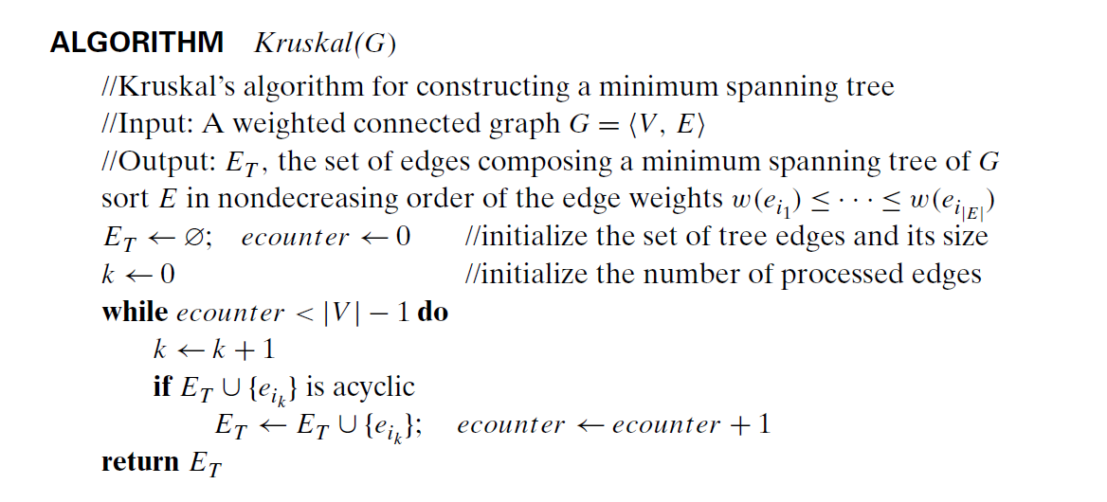
Kruskal’s Algorithm

Slide 63
Kruskal’s Algorithm
The implementation catch
Kruskal’s approach gives away an impression of being very easy to implement. It is really so?
Each time / iteration the algorithm should check whether adding the next edge to the edges already selected creates a cycle?
Remember a cycle is created iff the new edge connects two vertices which are already connected by a path

Slide 64
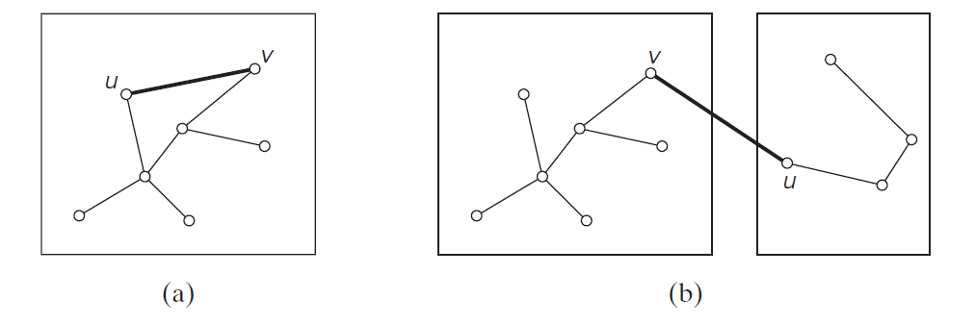
Kruskal’s Algorithm
The implementation catch
New cycle is created if and only if the two vertices belong to the same connected component
Each connected component of a subgraph generated by Kruskal’s algorithm is a tree because it has no cycles.

Slide 65
Kruskal’s Algorithm
The implementation catch
Consider the algorithm’s operations as a progression through a series of forests containing all the vertices of a given graph and some of its edges.
The initial forest consists of |V | trivial trees, each comprising a single vertex of the graph.
The final forest consists of a single tree, which is a minimum spanning tree of the graph.
On each iteration, the algorithm takes
the next edge (u, v) from the sorted list of the graph’s edges,
finds the trees containing the vertices u and v, and,
if these trees are not the same, unites them in a larger tree by adding the edge (u, v).

Slide 66
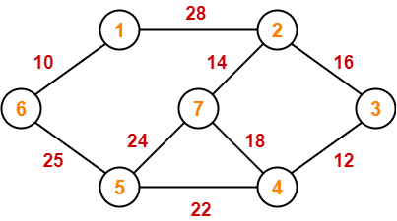
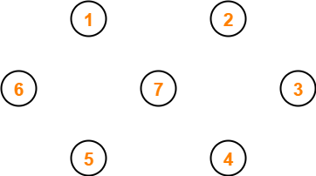
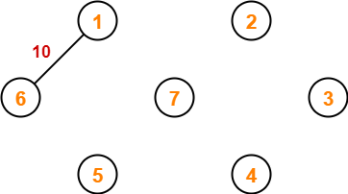
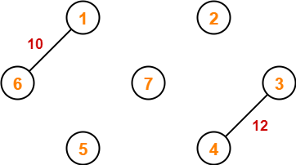
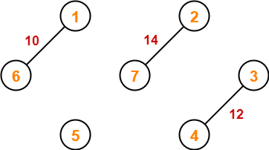
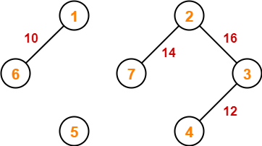
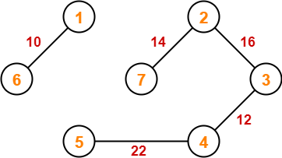
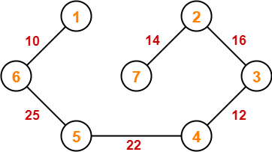
Kruskal’s Algorithm

Slide 67
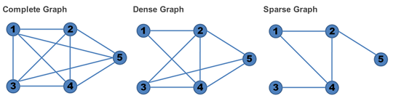
Differences between Prim’s and Kruskal’s
PRIM’S ALGORITHM | KRUSKAL’S ALGORITHM
It starts to build the Minimum Spanning Tree from any vertex in the graph. | It starts to build the Minimum Spanning Tree from the vertex carrying minimum weight in the graph.
It traverses one node more than one time to get the minimum distance. | It traverses one node only once.
Prim’s algorithm has a time complexity of O(V^2), V being the number of vertices. | Kruskal’s algorithm’s time complexity is O(logV), V being the number of vertices.
Prim’s algorithm gives connected component as well as it works only on connected graph. | Kruskal’s algorithm can generate forest(disconnected components) at any instant as well as it can work on disconnected components
Prim’s algorithm runs faster in dense graphs. | Kruskal’s algorithm runs faster in sparse graphs.
A graph in which the number of edges is much less than the possible number of edges
A graph in which the number of edges is close to the possible number of edges.

Slide 68
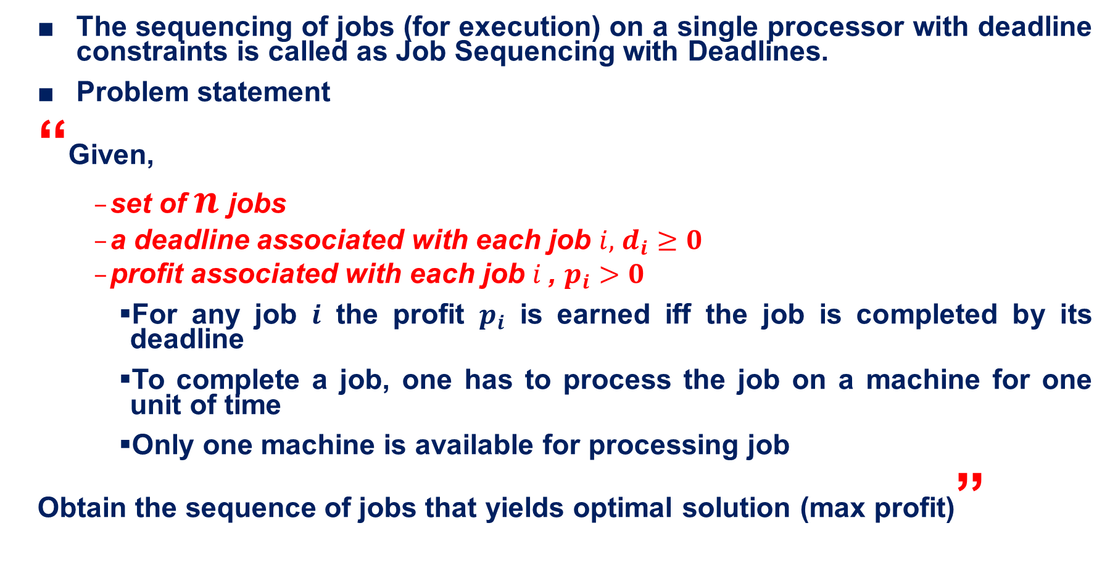
Job Sequencing with deadlines
The sequencing of jobs (for execution) on a single processor with deadline constraints is called as Job Sequencing with Deadlines.
Problem statement
“Given,
set of $n$jobs
a deadline associated with each job $i,$ $d_{i}≥0$
profit associated with each job $i$, $p_{i}>0$
For any job $i$ the profit $p_{i}$ is earned iff the job is completed by its deadline
To complete a job, one has to process the job on a machine for one unit of time
Only one machine is available for processing job
Obtain the sequence of jobs that yields optimal solution (max profit)”

Slide 69
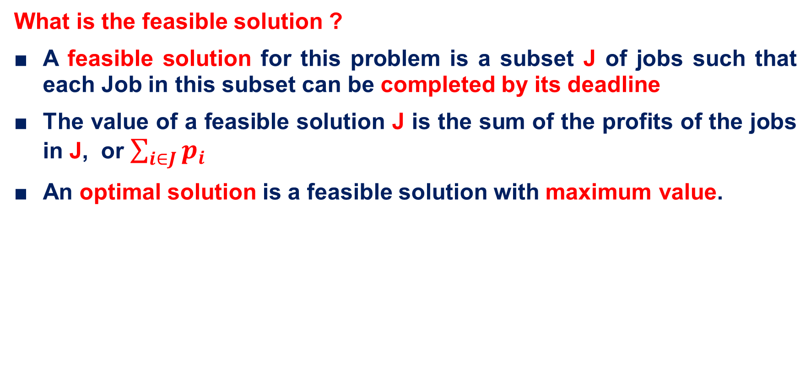
Job Sequencing with deadlines
What is the feasible solution ?
A feasible solution for this problem is a subset J of jobs such that each Job in this subset can be completed by its deadline
The value of a feasible solution J is the sum of the profits of the jobs in J, or $\sum_{i∈J}{p_{i}}$
An optimal solution is a feasible solution with maximum value.

Slide 70
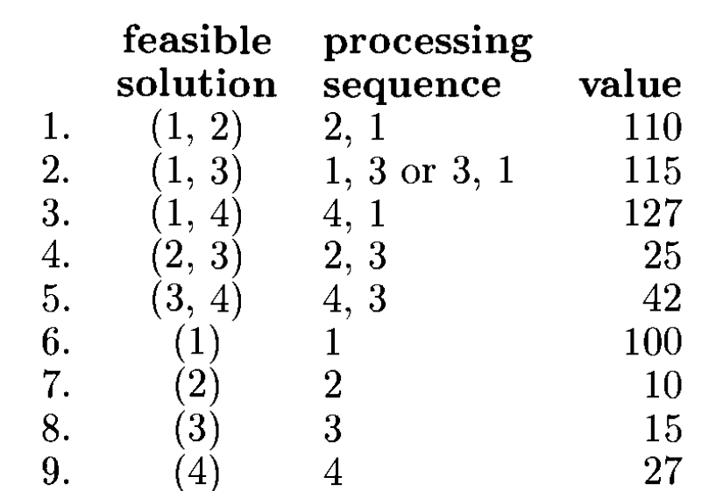

Job Sequencing with deadlines
Brute force approach
Solve the following instance of job sequencing problem
Let n = 4, (p1,p2,p3, p4)= (100,10,15, 27), (d1, d2, d3, d4)=(2, 1, 2, 1 )

Slide 71
Job Sequencing with deadlines
Greedy Approach
Sort all the given jobs in decreasing order of their profit.
Check the value of maximum deadline.
Draw a Gantt chart where maximum time on Gantt chart is the value of maximum deadline.
Select the jobs one by one.
Put the job on Gantt chart as far as possible from 0 ensuring that the job gets completed before its deadline.

Slide 72
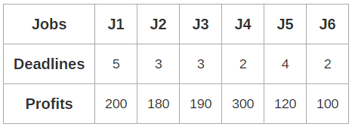
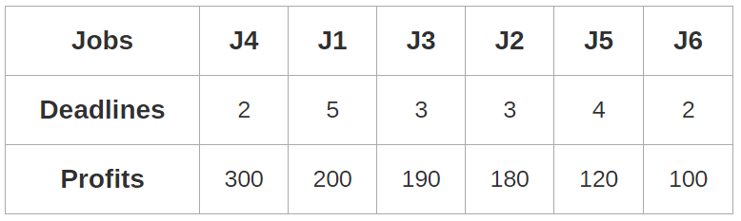
Job Sequencing with deadlines
Solve the following instance of job sequencing with deadline problem.
Solution
Sort all the given jobs in decreasing order of their profit.

Slide 73
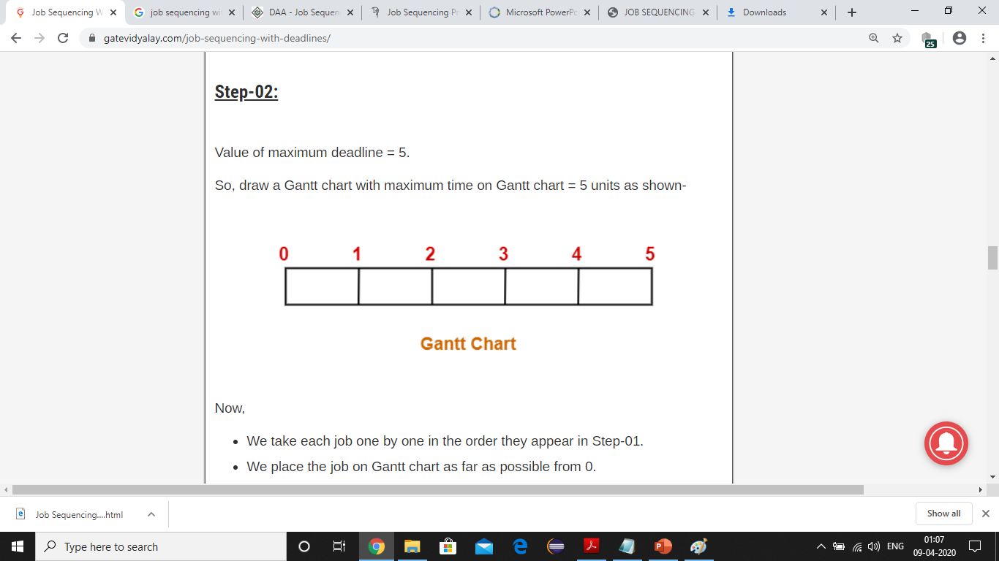
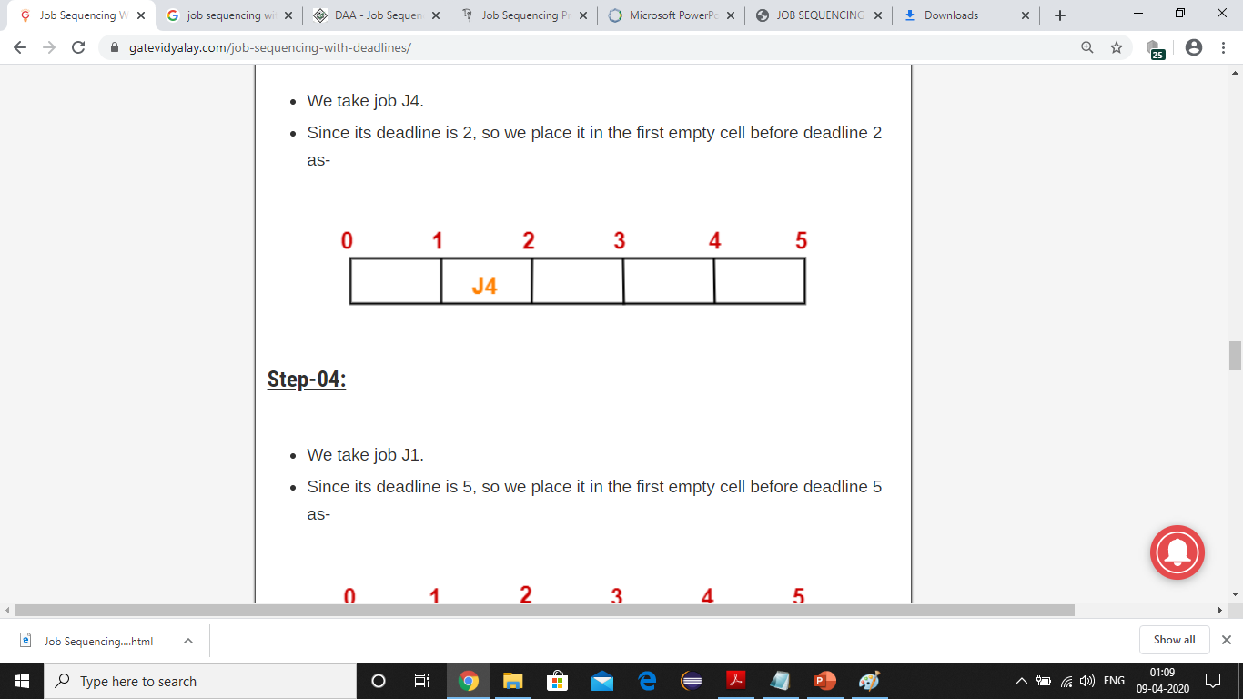
Job Sequencing with deadlines
Value of maximum deadline = 5.
So, draw a Gantt chart with maximum time on Gantt chart = 5 units as shown below
Select the jobs as per the ordered profits and place them in the chart accordingly
Select J4 ( d4=2)

Slide 74
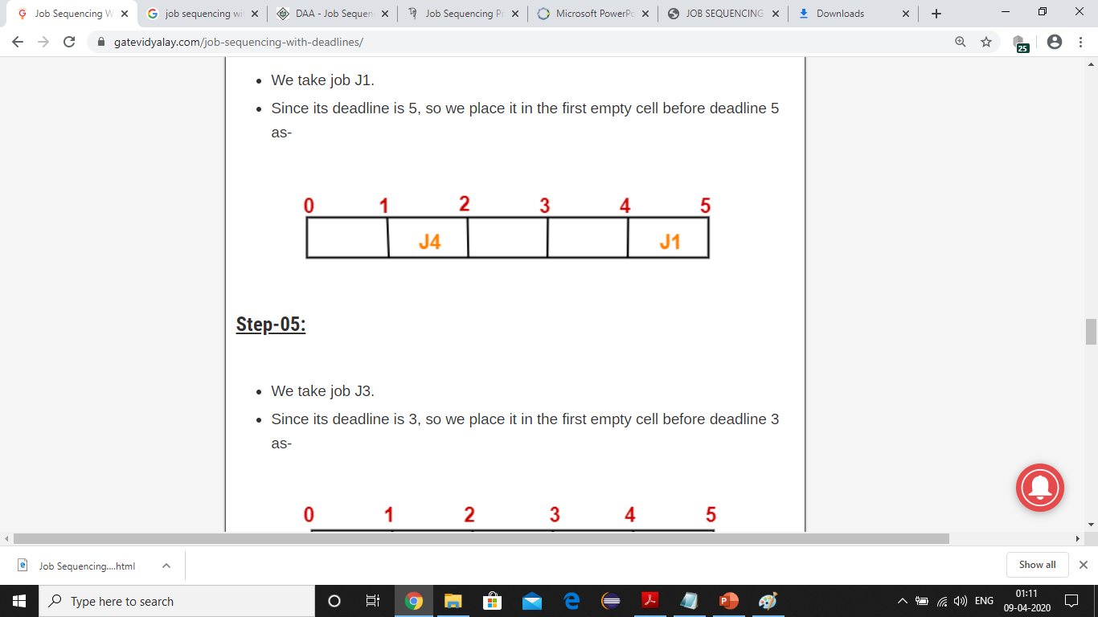
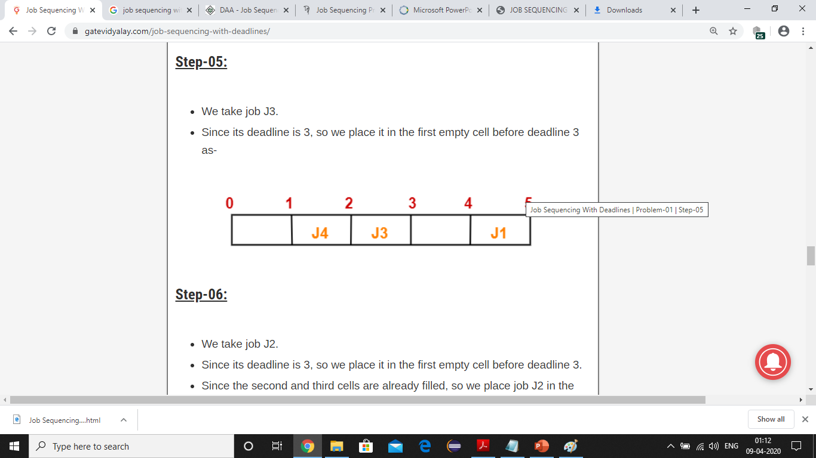
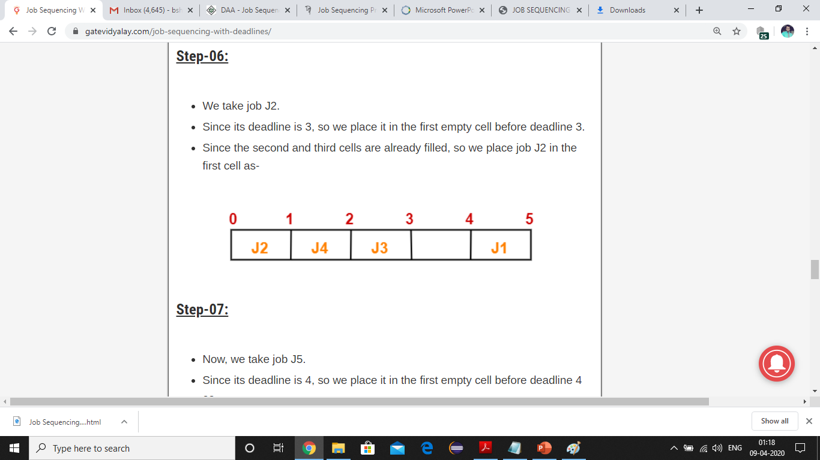
Job Sequencing with deadlines
Select J1 ( d1=5)
Select J3 (d3=3)
Select J2 (d2=3)

Slide 75
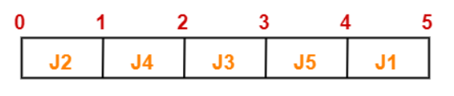
Job Sequencing with deadlines
Select J5 ( d5=4)
The left over job is J6 whose deadline is 2.
All the slots before deadline 2 are already occupied.
Thus, job J6 can not be completed.
Hence the optimal sequence of jobs are <J2, J4, J3, J5, J1>
The profit earned by this sequence is 990 units

Slide 76
Job Sequencing with deadlines
Solve the following instance of job sequencing problem
Let n = 4, (p1,p2,p3, p4)= (100,10,15, 27), (d1, d2, d3, d4)=(2, 1, 2, 1 )
Solution ?

Slide 77
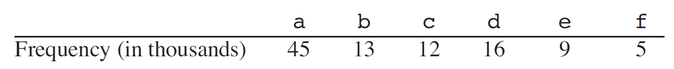
Huffman coding
Situation
How will you compactly store a data file of 100000 characters?
The file consists of only 6 different characters
Their occurrences (frequencies) are as follows
Designing a binary character code (in which each character is represented by a unique binary string, which we call a Codeword) is one among multiple solutions

Slide 78

Huffman coding
Fixed length code (e.g. ASCII)
3 bits to represent 6 characters
a = 000, b = 001, . . . , f = 101.
This method requires 300,000 bits to code the entire file
Can you do better ?

Slide 79
Huffman coding
Variable length code (Morse code)
assign frequent characters short codewords and infrequent characters long codewords
This code requires (45.1+13.3+12.3+16.3+9.4+5.4).1,000= 224,000 bits
When compared to fixed length code, the variable length code saved the storage by 25%

Slide 80
Huffman coding
Prefix codes
A code is called a prefix (free) code if no codeword is a prefix of another one. ( typically of variable length )
Example
A: 00
B: 010
C: 011
D: 10
E: 11
A: 00
B: 010
C: 001 # 011 -> 001
D: 10
E: 11
Prefix code
{3, 11, 22}
{1, 12, 13}
Not a Prefix code
Prefix code
Not a Prefix code

Slide 81
Huffman coding
Prefix codes
Life is easy with prefix code
Let [1, 2, 33, 34, 50, 61] be the codewords
Let the sequence of number received be 1611333425012
Decoding ?
1 61 1 33 34 2 50 1 2
https://gist.github.com/joepie91/26579e2f73ad903144dd5d75e2f03d83
https://leimao.github.io/blog/Huffman-Coding/

Slide 82
Huffman coding
David Huffman invented a greedy algorithm to
“Construct a tree that would assign shorter bit strings to high-frequency symbols and longer ones to low-frequency symbols”
He invented this when he was a graduate student at MIT
The two major steps in Huffman algorithm are
Building a Huffman Tree from the input characters.
Assigning code to the characters by traversing the Huffman Tree.

Slide 83
Huffman coding
Create a leaf node for each character of the text.
Arrange all the nodes in increasing order of their frequency value.
Considering the first two nodes having minimum frequency,
Create a new internal node.
The frequency of this new node is the sum of frequency of those two nodes.
Make the first node as a left child and the other node as a right child of the newly created node.
Keep repeating Step-2 and Step-3 until all the nodes form a single tree.
https://www.gatevidyalay.com/huffman-coding-huffman-encoding/

Slide 84

Huffman coding - Problem
A file contains the following characters with the frequencies as shown. If Huffman Coding is used for data compression, determine-
Huffman Code for each character
Average code length
Length of Huffman encoded message (in bits)

Slide 85


Huffman coding
Construction of Huffman tree

Slide 86

Huffman coding

Slide 87

Huffman coding

Slide 88

Huffman coding

Slide 89

Huffman coding

Slide 90

Huffman coding

Slide 91

Huffman coding

Slide 92

Huffman coding

Slide 93

Huffman coding
Huffman Tree

Slide 94

Huffman coding
Assign weight ‘0’ to the left edges and weight ‘1’ to the right edges of the Huffman Tree
a = 111
e = 10
i = 00
o = 11001
u = 1101
s = 01
t = 11000

Slide 95

Huffman coding
Construct the Huffman tree and hence obtain the codewords for the following population

Slide 96
Single source shortest path
Graphs can be used to model highway structure of a state/country.
Vertices representing cities and edges representing the connecting roads
The edges can be assigned weights which might represent distance/cost/time to drive across the cites
If Mr. X wants to drive from point A to point B
Following are the questions raised
Is there a path from A to B?
If there are multiple paths then which is the shortest path?

Slide 97
Single source shortest path
Graphs can be used to model highway structure of a state/country.
Vertices representing cities and edges representing the connecting roads
The edges can be assigned weights which might represent distance/cost/time to drive across the cites
If Mr. X wants to drive from point A to point B
Following are the questions raised
Is there a path from A to B?
If there are multiple paths then which is the shortest path?

Slide 98

Single source shortest path

Slide 99
Single source shortest path
The problem statement
Given a weighted connected graph G=(V, E) and a source vertex s, determine the shortest paths from s to all the remaining vertices.
The single-source shortest-paths problem asks for a family of paths, each leading from the source to a different vertex in the graph, though some paths may, of course, have edges in common.
Major applications
Transportation planning
Packet routing in Internet
Social networks
Speech recognition
Path finding video games

Slide 100
Single source shortest path
Dijkstra’s Algorithm
Best-known algorithm for the single-source shortest-paths problem
This algorithm is applicable to undirected and directed graphs with nonnegative weights only
Dijkstra’s algorithm finds the shortest paths to a graph’s vertices in order of their distance from a given source
First, it finds the shortest path from the source to a vertex nearest to it then to a second nearest, and so on
In general, before its ith iteration commences, the algorithm has already identified the shortest paths to i − 1 other vertices nearest to the source.

Slide 101

Single source shortest path
Working of Dijkstra’s algorithm
Fringe vertices?
The set of vertices adjacent to the vertices in Ti
How to identify next nearest vertex? u*

Slide 102
Single source shortest path
After identifying do the following
Move u* from the fringe to the set of tree vertices.
For each remaining fringe vertex u that is connected to u* by an edge of weight w(u*, u) such that du* + w(u*, u) < du, update the labels of u by u* and du* + w(u*, u), respectively.

Slide 103


Single source shortest path
Find the shortest paths from the source vertex a to all other vertices
Adjacency Matrix
Solution

Slide 104
Heaps and Heap Sort
Partially ordered data structure that is especially suitable for implementing priority queues
A heap can be defined as a binary tree with keys assigned to its nodes, one key per node, provided these two conditions are met:
The shape property
The binary tree is essentially complete (or simply complete), i.e., all its levels are full except possibly the last level, where only some rightmost leaves may be missing.
The parental dominance or heap property
The key in each node is greater than or equal to the keys in its children. (This condition is considered automatically satisfied for all leaves.)

Slide 105



Heaps and Heap Sort
Note
key values in a heap are ordered top down
there is no left-to-right order in key values;

Slide 106
Heaps and Heap Sort
Properties of Heap
There exists exactly one essentially complete binary tree with n nodes. Its height is equal to log₂n.
The root of a heap always contains its largest element.
A node of a heap considered with all its descendants is also a heap.
A heap can be implemented as an array by recording its elements in the top down, left-to-right fashion
It is convenient to store the heap’s elements in positions 1 through n of such an array, leaving H[0] either unused

Slide 107


Heaps and Heap Sort
In an array representation of heaps
the parental node keys will be in the first $\left\lfloor n/2\right\rfloor$ positions of the array, while the leaf keys will occupy the last $\left\lceil n/2\right\rceil$ positions;
the children of a key in the array’s parental position $i (1≤ i ≤ n/2)$willbe in positions 2i and 2i + 1, and, correspondingly, the parent of a key in position i (2 ≤ i ≤ n) will be in position $\left\lfloor i/2\right\rfloor$

Slide 108
Heaps and Heap Sort
How to construct a heap for a given list of keys?
bottom-up heap construction
It initializes the essentially complete binary tree with n nodes by placing keys in the order given
then “heapifies” the tree
top-down heap construction
Successive insertions of a new key into a previously constructed heap
Bottom-up heap construction
Example : construct a heap for the following list of numbers
2, 9, 7, 6, 5, 8.

Slide 109
Heaps and Heap Sort
Bottom-up heap construction
It initializes the essentially complete binary tree with n nodes by placing keys in the order given
Heapify
Starting with the last parental node, the algorithm checks whether the parental dominance holds for the key in this node
If it does not, the algorithm exchanges the node’s key K with the larger key of its children and checks whether the parental dominance holds for K in its new position
This process continues until the parental dominance for K is satisfied.
After completing the “heapification” of the subtree rooted at the current parental node, the algorithm proceeds to do the same for the node’s immediate predecessor
The algorithm stops after this is done for the root of the tree.

Slide 110






Heaps and Heap Sort
Example : Construct a heap for the following list of numbers
2, 9, 7, 6, 5, 8.

Slide 111

Heaps and Heap Sort
construct a heap for the following list of numbers
4, 1, 3, 2, 16, 9, 10, 14, 8, 7

Slide 112

Heaps and Heap Sort

Slide 113
Heaps and Heap Sort
Top-down heap construction
Successive insertions of a new key into a previously constructed heap
How to insert a new key K into a heap?
First, attach a new node with key K in it after the last leaf of the existing heap.
Then shift K up to its appropriate place in the new heap as follows.
Compare K with its parent’s key: if the latter is greater than or equal to K, stop (the structure is a heap);
Otherwise, swap these two keys and compare K with its new parent.
This swapping continues until K is not greater than its last parent or it reaches the root

Slide 114



Heaps and Heap Sort
top-down heap construction
Successive insertions of a new key into a previously constructed heap

Slide 115

Heaps and Heap Sort
How to delete an item form the heap?
Special case- Deletion of root

Slide 116

Heaps and Heap Sort
Steps illustrating the deletion of root element from the heap

Slide 117
Heaps and Heap Sort
Heap Sort
An interesting sorting algorithm discovered by J. W. J. Williams
This is a two-stage algorithm that works as follows.
Stage 1 (heap construction): Construct a heap for a given array.
Stage 2 (maximum deletions): Apply the root-deletion operation n − 1 times to the remaining heap.

Slide 118


Heaps and Heap Sort
Sort the following elements using heap sort
2, 9, 7, 6, 5, 8

Slide 119

Greedy Method

